Slide 1
Unit - 3
Inheritance
Interfaces

Slide 2
Inheritance Basics
What is an Ostrich?
What is a Duck?
What is a Penguin?
Who are you?
Student → person → Mammal → Animal
Sedan → Car → LandVehicle → Vehicle

Slide 3
Inheritance Basics
One of the three fundamental principles of OOP.
Allows hierarchical classification.
Create a general class that defines traits common to a set of related items. (Generalization)
This class can then be inherited by other, more specific classes each adding those things that are unique to it. (Specialization)
A class that is inherited is called superclass, base class or parent class.
The class that does the inheritance is called a subclass, derived class or child class.

Slide 4
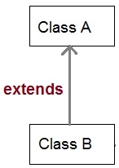
If A is a superclass, the keyword extends is used to create a subclass of A.
class subclass-name extends superclass-name
{
}
Example:
class A {
//Members and methods declarations
}
class B extends A {
//Members and methods from A are inherited
//Members and methods declarations of B
}

Slide 5
Member Access and Inheritance
Although a subclass includes all of the members of its superclass, it cannot access those members of the superclass that have been declared as private.
A class member that has been declared as private will remain private to its class.
It is not accessible by any code outside its class, including subclasses.

Slide 6
class Rectangle {
private double length, width;
void setRectangle(double length, double width) {
this.length = length;
this.width = width;
}
double getArea() {
return length * width;
}
}
class Box extends Rectangle {
private double height;
void setBox(double length, double width, double height) {
setRectangle(length,width);
this.height = height;
}
double getVolume() {
return getArea() * height;
}
}
public class InheritExample {
public static void main(String[] args) {
Box room = new Box();
room.setBox(12.5, 10.5, 9.5);
System.out.println("Volume is " + room.getVolume());
}
}
Cannot be accessed by Box class
Getters or Accessor methods are used by the subclass and other classes to obtain value of private data members

Slide 7
length
width
Rectangle
setRectangle()
getArea()
Box
height
setBox()
getVolume()

Slide 8
Constructors and Inheritance
It is possible to have constructors for both superclass and subclasses.
Which constructor is responsible for building an object of the subclass – the one in superclass, the one in subclass, or both?
Answer: The constructor for the superclass constructs the superclass portion of the object, and the constructor for the subclass constructs the subclass part.
In a class hierarchy, constructors are called in the order of derivation, from superclass to subclass.

Slide 9
class Person {
Person() {
System.out.println("Constructor of person class");
}
}
class Employee extends Person {
Employee() {
System.out.println("Constructor of employee class");
}
}
class PermanentEmployee extends Employee {
PermanentEmployee() {
System.out.println("Constructor of permanent employee class");
}
}
class ConstructorInheritanceDemo {
public static void main(String args()) {
PermanentEmployee pObj = new PermanentEmployee();
}
}
Output:
Constructor of person class
Constructor of employee class
Constructor of permanent employee class

Slide 10
When both the superclass and the subclass define constructors, the process is a bit more complicated because both the superclass and subclass constructors must be executed.
In this case, you must use the keyword super.
super has two uses:
It can be used to call the superclass constructor.
It can be used to access a member of the superclass that has been hidden by a member of the subclass.

Slide 11
Using super to call Superclass Constructors
A subclass can call a constructor defined by its superclass by use of the following form of super:
super(parameter_list);
Here parameter_list specifies any parameters needed by the constructor of the superclass.
super() must always be the first statement executed inside a subclass constructor.

Slide 12
class Person {
String FirstName, LastName;
Person(String fName, String lName) {
FirstName = fName;
LastName = lName;
} }
class Student extends Person {
int id;
String standard, classTeacher;
Student(String fName, String lName, int sId, String stnd, String cTeacher) {
super(fName,lName);
id = sId;
standard = stnd;
classTeacher = cTeacher;
} }
class SuperKeywordForConstructorDemo {
public static void main(String args[]) {
Student sObj = new Student(“Amit",“Patil",1,“II- B",“RMK");
}
}

Slide 13
class TwoDShape {
double width, height;
TwoDShape() {
width = height = 0;
}
TwoDShape(double w, double h) {
widht = w;
height = h;
}
TwoDShape(double x) {
width = height = x;
}
}
class Trianle extends TwoDShape {
Triangle() {
super();
}
Triangle(double w, double h) {
super(w, h);
}
Triangle(double x) {
super(x);
}
}
Any form of constructor defined by the superclass can be called by using the keyword super(). The constructor executed will be the one that matches the arguments.

Slide 14
Using super to Access Superclass Members
super.member
Here, member can be either a method or an instance variable.
This is useful in situations where member names of a subclass hide members by the same name in the superclass.

Slide 15
class A {
int i;
}
class B extends A {
int i;
B(int a, int b) {
super.i= a;
i = b;
}
void show() {
System.out.println("i in superclass: " + super.i);
System.out.println("i in subclass: " + i);
}
}
class UseSuper {
public static void main(String args[]) {
B subOb = new B(1, 2);
subOb.show();
}
}
Output:
i in superclass: 1
i in subclass: 2

Slide 16
Method Overriding
In a class hierarchy, when a method in a subclass has the same return type, name and signature as a method in its superclass, then the method is said to override the method in the superclass.
When an overridden method is called from within a subclass, it will always refer to the version of the method defined by that subclass.
The version of the method defined by the superclass will be hidden.
Overriding provides the ability to define a behavior that is specific to the subclass type.

Slide 17
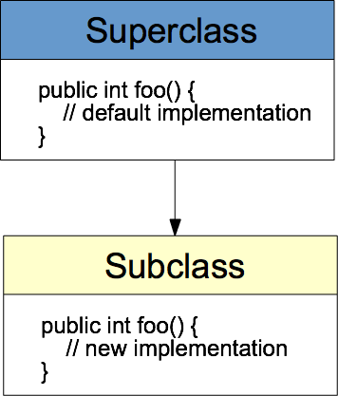

Slide 18
Method overriding is one of the way by which java achieves Run Time Polymorphism.
The version of a method that is executed will be determined by the object that is used to invoke it.
If an object of a parent class is used to invoke the method, then the version in the parent class will be executed, but if an object of the subclass is used to invoke the method, then the version in the child class will be executed.
In other words, it is the type of the object being referred to (not the type of the reference variable) that determines which version of an overridden method will be executed.

Slide 19
Method overriding
public class Animal
{
public void makeSound()
{
System.out.println("the animal makes sounds");
}
}
public class Dog extends Animal
{
public void makeSound()
{
System.out.println("the dog barks");
}
}

Slide 20
Method overriding
class Bank
{
int getRateOfInterest(){return 0;}
}
class SBI extends Bank
{
int getRateOfInterest(){return 8;}
}
class ICICI extends Bank
{
int getRateOfInterest(){return 7;}
}
class AXIS extends Bank
{
int getRateOfInterest(){return 9;}
}

Slide 21
Overridden Methods Support Polymorphism
Method overriding forms the basis for one of Java’s most powerful concepts: dynamic method dispatch
It is a mechanism by which a call to an overridden method is resolved at run time rather than compile time.
This is how Java implements run-time polymorphism.

Slide 22
When an overridden method is called through superclass reference…..
A superclass reference variable can refer to a subclass object.
Java uses this fact to resolve calls to overridden methods at run time.
Java determines which version of that method to execute based on the type of the object being referred to at the time of the call.
This determination is done at run-time.
It is the type of the object being referred to (not the type of the reference variable) that determines which version of an overridden method will be executed.

Slide 23
Example for Dynamic Method Dispatch
Employee
computeSalary()
printDetails()
class Employee {
static double basic = 20000;
String empName;
int empID;
Employee(String name, int id) {
empName = name;
empID = id;
}
void computeSalary() {
}
void printDetails() {
System.out.println("Name:" + empName);
System.out.println("Employee ID: " +empID);
}
}
SalesManager
ProjectManager
computeSalary()
printDetails()
computeSalary()
printDetails()

Slide 24
class SalesManager extends Employee {
static double da = 0.65, hra = 0.85;
static int comm = 10000;
double salary;
SalesManager(String name, int id) {
super(name, id);
}
void computeSalary() {
salary = basic + basic * da + basic * hra + comm;
}
void printDetails() {
super.printDetails();
System.out.println("Salary: " + salary);
}
}

Slide 25
class ProjectManager extends Employee {
static double da = 0.70, hra = 0.9;
static int allowance = 15000;
double salary;
ProjectManager(String name, int id) {
super(name, id);
}
void computeSalary() {
salary = basic + basic * da + basic * hra + allowance;
}
void printDetails() {
super.printDetails();
System.out.println("Salary: " + salary);
}
}

Slide 26
public class OverridingDemo {
public static void main(String[] args) {
Employee e1;
SalesManager s1 = new SalesManager("Sachin T", 101);
ProjectManager p1 = new ProjectManager("Ramesh", 201);
s1.computeSalary();
s1.printDetails();
p1.computeSalary();
p1.printDetails();
e1 = s1;
e1.computeSalary();
e1 = p1;
e1.computeSalary();
}
}

Slide 27
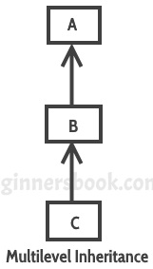
Creating a Multilevel Hierarchy
The relationships of objects or classes through inheritance give rise to a hierarchy.
In multilevel inheritance, a subclass is inherited from another subclass.
It is not uncommon that a class is derived from another derived class as shown in the figure.
The class A serves as a base class for the derived class B, which in turn serves as a base class for the derived class C.
The class B is known as intermediate base class since it provides a link for the inheritance between A and C.
In such a hierarchy, super() always refers to the constructor in the closest superclass.

Slide 28
Syntax of Multilevel Inheritance
class A {
//Do something
}
class B extends A {
//Do something
}
class C extends B {
//Do something
}

Slide 29
Person
Employee
HourlyEmployee

Slide 30
class person {
private String name;
person(String s) {
setName(s);
}
public void setName(String s) {
name = s;
}
public String getName() {
return name;
}
public void display() {
System.out.println("Name = " + name);
}
}

Slide 31
class Employee extends person {
private int empid;
Employee(String sname,int id) {
super(sname);
setEmpid(id);
}
public void setEmpid(int id) {
empid = id;
}
public int getEmpid() {
return empid;
}
public void display() {
super.display();
System.out.println("Empid = " + empid);
}
}

Slide 32
class HourlyEmployee extends Employee {
private double hourlyRate;
private int hoursWorked;
HourlyEmployee(String sname,int id,double hr,int hw) {
super(sname,id);
hourlyRate = hr;
hoursWorked = hw;
}
public double GetGrosspay() {
return (hourlyRate * hoursWorked);
}
public void display() {
super.display();
System.out.println("Hourly Rate = " + hourlyRate);
System.out.println("Hours Worked = " + hoursWorked);
System.out.println("Gross pay = " + GetGrosspay());
}
}

Slide 33
class MultilevelInheritance {
public static void main(String[] args) {
HourlyEmployee emp = new HourlyEmployee(
"Kapil Sharma", 1, 1000, 28);
emp.display();
}
}

Slide 34
When are Constructors Executed?
In a class hierarchy, constructors are called in the order of derivation, from superclass to subclass. Why is that so?
Because a superclass has no knowledge of any subclass, any initialization it needs to perform is separate from and a prerequisite to any initialization performed by the subclass.
Since super() must be the first statement executed in a subclass’ constructor, this order is the same whether or not super() is used.
If super() is not used, then the default constructor of each superclass will be executed.

Slide 35
class A
{
A()
{ System.out.println("Inside A's constructor."); }
}
class B extends A
{
B()
{ System.out.println("Inside B's constructor."); }
}
class C extends B
{
C() { System.out.println("Inside C's constructor."); }
}
class CallingCons
{
public static void main(String args[])
{
C c = new C();
}
}

Slide 36
Superclass References and Subclass Objects
In Java, type compatibility is strictly enforced. Hence, a reference variable for one class type cannot refer to an object of another class type.
However, an object reference variable can refer to objects of its type.
class A {
int a;
A(int i) { a= i; }
}
class B {
int a;
B(int i) { a= i; }
}
class Incompatible {
public static void main(String [] args) {
A ob1 = new A(10);
A ob2;
B ob3 = new B(10);
ob2 = ob1; // OK, both are same type
ob2 = ob3; // Error, not of same type
}
Even though class A and class B are physically same, it is not possible to assign to an A variable a reference to a B object because they have different types.

Slide 37
Four ways to assign superclass and subclass references to variables of superclass and subclass types
Assigning a superclass reference to a superclass variable is straightforward.
Assigning a subclass reference to a subclass variable is straightforward.
Assigning a subclass reference to a superclass variable is safe, because the subclass object is an object of its superclass.
The superclass variable can be used to refer only to superclass members.
If this code refers to subclass-only members through the superclass variable, the compiler reports errors.
Attempting to assign a superclass reference to a subclass variable is a compilation error.

Slide 38
class Person {
String name;
int age;
Person(String n, int a) {
name = n;
age = a;
}
void showDetails() {
System.out.println("Name: " + name);
System.out.println("Age: " + age);
}
}

Slide 39
class Student extends Person {
int rollNo;
int phy, chem, mat;
Student(String n, int a, int rno, int m1, int m2, int m3) {
super(n, a);
rollNo = rno;
phy = m1;
chem = m2;
mat = m3;
}
void showDetails() {
super.showDetails();
System.out.println("Roll Number: " + rollNo);
System.out.println("Physics: " + phy);
System.out.println("Chemistry: " + chem);
System.out.println("Maths: " + mat);
}
void showAvg() {
float avg = (float) (phy + chem + mat) / 2.0f;
System.out.println("Average: " + avg);
}
}

Slide 40
public class Test {
public static void main(String[] args) {
Student s1 = new Student("Ramesh", 21, 1, 23, 24, 21);
Person p1 = s1;
p1.showDetails();
p1.showAvg(); //ERROR: cannot find symbol
((Student)p1).showAvg();
s1.showAvg();
Person p2 = new Person("Sachin", 32);
Student s2 = p2; //ERROR: incompatible types
Student s3 = (Student) p2; // OK.
s2.showAvg();
s2.showDetails();
}
}

Slide 41
Shape
Circle
Triangle
Rectangle
Square

Slide 42
Base class - Shape
class Shape
{
float area, perimeter;
String type;
void display()
{
System.out.println("I am a " + type);
System.out.println("Area is " + area);
System.out.println("Perimeter is " +
perimeter);
}
}

Slide 43
Derived class - Circle
class Circle extends Shape
{
float radius;
Circle(float rad)
{
type = "Circle";
radius = rad;
}
void computeArea()
{
area = 3.142f * radius * radius;
}
void computePerimeter()
{
perimeter = 2.0f * 3.142f * radius;
}
}

Slide 44
Derived class - Triangle
class Triangle extends Shape
{
float a, b, c;
Triangle(float s1, float s2, float s3)
{
type = "Triangle";
a = s1; b = s2; c = s3;
}
void computeArea()
{
float s = (a + b + c) / 2.0f;
area = (float) Math.sqrt(s*(s - a)*(s - b)*(s - c));
}
void computePerimeter()
{
perimeter = a + b + c;
}
}

Slide 45
Derived class - Rectangle
class Rectangle extends Shape
{
float length, width;
Rectangle(float len, float wid)
{
type = "Rectangle";
length = len;
width = wid;
}
void computeArea()
{
area = length * width;
}
void computePerimeter()
{
perimeter = 2.0f * (length + width);
}
}

Slide 46
Using abstract classes
A class that is declared using “abstract” keyword is known as abstract class.
It can have abstract methods(methods without body) as well as concrete methods (regular methods with body).
A normal class(non-abstract class) cannot have abstract methods.
An abstract class can not be instantiated, which means you are not allowed to create an object of it.

Slide 47
Abstract class declaration An abstract class outlines the methods but not necessarily implements all the methods.
// Declaration using abstract keyword
abstract class A
{
// This is abstract method
abstract void myMethod();
// This is concrete method with body
void anotherMethod()
{
//Does something
}
}

Slide 48
Rules for abstract classes
A class derived from the abstract class must implement all those methods that are declared as abstract in the base class.
Abstract class cannot be instantiated.
If a derived class does not implement all the abstract methods of abstract base class, then the derived class must need to be declared abstract as well.

Slide 49
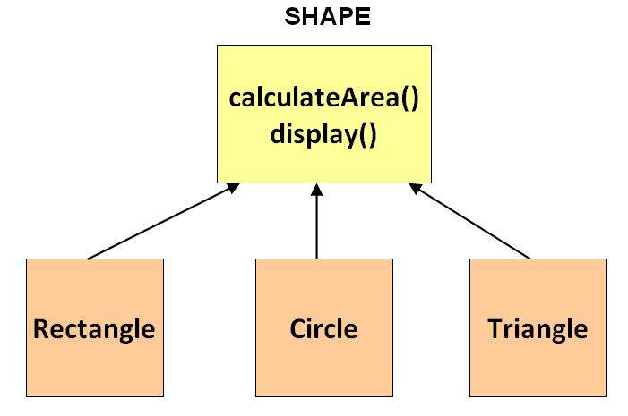
How these objects will look in a practical world?

Slide 50
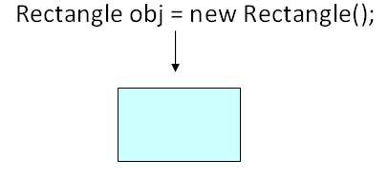
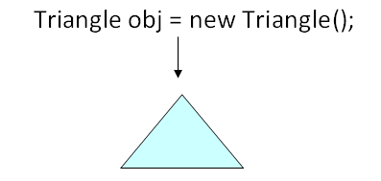
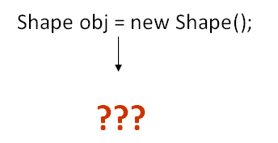
Observe that the Shape class serves our goal of achieving inheritance and polymorphism. But it was not built to be instantiated. Such classes are labeled abstract.

Slide 51
Shape class Revisited…
abstract class Shape
{
float area, perimeter;
String type;
void display()
{
System.out.println("I am a " + type);
System.out.println("Area is " + area);
System.out.println("Perimeter is " + perimeter);
}
abstract void computeArea();
abstract void computePerimeter();
}
subclasses must implement these two methods

Slide 52
Reference of an abstract class can point to objects of its subclasses thereby achieving run-time polymorphism.
Shape obj = new Rectangle(4, 5); OR
Shape obj;
Rectangle r1 = new Rectangle(4, 5);
obj = r1;
obj1.computeArea();
obj1.computePerimeter();
obj1.display();

Slide 53
Using final with Inheritance
The keyword final has three uses.
It can be used to create the equivalent of a named constant. We cannot change the value of final variable.
class Bike
{
final int SPEEDLIMIT=90;
}

Slide 54
It can be used to disallow a method from being overridden.
A final method is inherited but you cannot override it.
class Bike
{
final void run()
{
System.out.println("running");
}
}

Slide 55
Can we declare a class as both abstract and final?
It can be used to prevent a class from being inherited.
Declaring a class as final implicitly declares all of its methods as final, too.
final class Bike
{
... ...
}
class Honda1 extends Bike // Error!
{
void run()
{
System.out.println("running at 100kmph");
}
}

Slide 56
The Object class
Mother of all Java classes!!
Java defines one special class called Object that is an implicit superclass of all other classes.
A reference variable of type Object can refer to an object of any other class.
Since arrays are implemented as classes, a variable of type Object can also refer to any array.

Slide 57
Methods of Object class
Object clone()
Creates a new object that is the same as the object being cloned.
boolean equals(Object ob)
Determines whether one object is equal to another.
void finalize()
Called before an unused object is recycled.
class<?> getClass()
Obtains the class of an object at run time.
String toString()
Returns a string that describes the object
int hashCode()
Returns the hash code associated with the invoking object.
wait(), notify() are used multithreading.

Slide 58
finalize
This method is called just before an object is garbage collected.
It is called by the Garbage Collector on an object when garbage collector determines that there are no more references to the object.
We should override finalize() method to dispose system resources, perform clean-up activities and minimize memory leaks.
For example before destroying Servlet objects web container, always called finalize method to perform clean-up activities of the session.

Slide 59
finalize()
public class Test {
public static void main(String[] args) {
Test t = new Test();
System.out.println(t.hashCode());
t = null;
// calling garbage collector
System.gc();
System.out.println("end");
}
@Override
protected void finalize() {
System.out.println("finalize method called");
}
}

Slide 60
clone()
clone() – returns a new object that is exactly the same as this object
equals() - Compares the given object to “this” object
class Rectangle implements Cloneable
{
float length, width;
Rectangle(float len, float wid)
{
type = "Rectangle";
length = len;
width = wid;
}
public Object clone() throws CloneNotSupportedException {
return super.clone();
}
public static void main(String[] args) throws CloneNotSupportedException {
r1 = Rectangle(4, 5);
Rectangle r2 = (Rectangle)r1.clone(); // Different objects
Rectangle r3 = r1; // r3 holds the same object reference and hence has the same object
if(r2.equals(r1)) // False
if(r3.equals(r1)) // True

Slide 61
getClass()
Returns the class object of “this” object
{
Object obj = new String("Hello World!");
Class c = obj.getClass();
Rectangle r1 = new Rectangle(4, 5);
Class d = r1.getClass();
System.out.println("Class of Object obj is : " + c.getName());
System.out.println("Class of Object obj is : " + d.getName());
}
Output:
Class of Object obj is : java.lang.String
Class of Object obj is : shapeclass.Rectangle

Slide 62
hashcode()
Returns a hash value that is used to search object in a collection.
For every object, JVM generates a unique number which is hashcode. It returns distinct integers for distinct objects (not the address of object!)
{
ShapeClass t = new ShapeClass();
System.out.println(t.hashCode());
}

Slide 63
toString()
Provides String representation of an Object and used to convert an object to String.
Returns class name, then @, then unsigned hexadecimal representation of the hash code of the object
System.out.println(r1.toString()); returns
shapeclass.Rectangle@7852e922
Whenever we try to print any Object reference, then internally toString() method is called.
Student s = new Student();
// Below two statements are equivalent
System.out.println(s);
System.out.println(s.toString());

Slide 64
Interfaces

Slide 65
Interface Fundamentals
Interface defines a set of methods that will be implemented by a class.
Syntactically, interfaces are similar to abstract classes, except that no method can include a body.
Interface does not provide implementation of the method it defines.
Therefore, an interface simply specifies what must be done, but not how.
Interface is a construct that describes functionality without specifying implementation.

Slide 66
Once an interface is defined, any number of classes can implement it.
This makes it possible for two or more classes to provide the same functionality even though they might do it in different ways.
Furthermore, one class can implement any number of interfaces.

Slide 67
Difference between Class and Interface
In class, you can instantiate variable and create an object.
Class can contain concrete(with implementation) methods.
The access specifiers used with classes are private, protected and public.
In an interface, you can't instantiate variable and create an object.
The interface cannot contain concrete(with implementation) methods.
In Interface only one specifier is used- Public.

Slide 68
General form of Interface Declaration
access interface name {
ret_type method_name(param_list);
ret_type method_name(param_list);
// …
ret_type method_name(param_list);
}
Here access is either public (commonly) or not used (default).
name can be any valid identifier.
Methods inside the interface are essentially abstract methods.
No method can have an implementation.
It is the responsibility of each class that includes an interface to provide the implementation.
In an interface methods are implicitly public.

Slide 69
Creating an Interface
interface Animal { public void animalSound(); // interface method (does not have a body) public void sleep(); // interface method (does not have a body) }
class Duck implements Animal { public void animalSound() { // The body of animalSound() is provided here System.out.println("The Duck says: Quack Quack"); } public void sleep() { // The body of sleep() is provided here System.out.println("Zzz"); } }
class MyMainClass { public static void main(String[] args) { Duck d1 = new Duck(); // Create a Duck object d1.animalSound(); d1.sleep(); } }

Slide 70
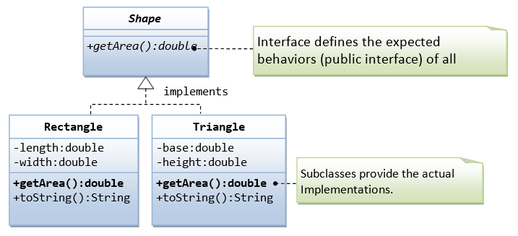

Slide 71
interface Shape {
double getArea();
}
class Rectangle implements Shape {
private int length;
private int width;
public Rectangle(int length, int width) {
this.length = length;
this.width = width;
}
@Override
public String toString() {
return "Rectangle[length=" + length + ",width=" + width + "]";
}
@Override
public double getArea() {
return length * width;
}
}

Slide 72
class Triangle implements Shape { // More than one class can //implement an interface
private int base;
private int height;
public Triangle(int base, int height) {
this.base = base;
this.height = height;
}
@Override
public String toString() { // We can define new methods
return "Triangle[base=" + base + ",height=" + height + "]";
}
@Override
public double getArea() {
return 0.5 * base * height;
}
void display() {
System.out.println(“Hello World”);
}
}

Slide 73
IPrime is an interface
isPrime() abstract method
PrimeTester class implements IPrime
ImprovedPrimeTester
FurtherImprovedPrimeTester
FastestPrimeTester -- >Fermat’s method

Slide 74
Using Interface References
When we define a class, we are creating a new reference type.
An interface declaration also creates a new reference type.
When a class implements an interface, it is adding that interface’s type to its type.
As a result, an instance of a class that implements an interface is also an instance of that interface type.
An interface reference variable can refer to any instance of its type.
When we call a method on an object through an interface reference, it is the version of the method implemented by the object that is executed. (Similar to using a superclass reference to access a subclass object)

Slide 75
public class InterfaceTest {
public static void main(String[] args) {
Shape s1;
s1 = new Rectangle(1, 2); // upcast
System.out.println(s1);
System.out.println("Area is " + s1.getArea());
Triangle t1 = new Triangle(3, 4);
t1.display();
Shape s2 = t1;
s2.display();
System.out.println(s2);
System.out.println("Area is " + s2.getArea());
// Cannot create instance of an interface
//Shape s3 = new Shape("green"); // Compilation Error!!
}
}
Note: An interface reference variable has knowledge only of the methods declared by its interface declaration. It cannot be used to access any other variables or methods that might be provided by an implementing class.

Slide 76
Implementing Multiple Interfaces
public interface GPS {
public void getCoordinates();
}
public interface Radio {
public void startRadio();
public void stopRadio();
}
public class Smartphone implements GPS, Radio {
public void getCoordinates() {
// return some coordinates
}
public void startRadio() {
// start Radio
}
public void stopRadio() {
// stop Radio
}
}
If a Class implements multiple Interfaces, then there could be a chance of method signature overlap. Since Java does not allow multiple methods of the exact same signature, this can lead to ambiguity.

Slide 77
Constants in Interfaces
Apart from declaring methods, an interface can also include variables.
However, such “variables” are not instance variables. Instead, they are implicitly public, final and static and must be initialized.
Thus, they are essentially constants.
A large program often makes use of several constant values such as array size, limits, special values, that could be used by several classes in that program.
An interface can be used to make such constants available to each class.

Slide 78
interface Status {
int OPEN = 1;
int CLOSED = 2;
}
However, the constant interface pattern is a poor use of interfaces. Instead use,
public final class Status {
public static final int OPEN = 1;
public static final int CLOSED = 2;
}

Slide 79
Interfaces can be Extended
One interface can inherit another by use of the keyword extends.
The syntax is the same as for inheriting classes.
When a class implements an interface that inherits another interface, it must provide implementations for all methods defined within the interface inheritance chain.

Slide 80
Nested Interfaces
An interface can be declared a member of another interface or of a class.
Such an interface is called a member interface or a nested interface.
An interface nested in a class can use any access modifier. An interface nested in another interface is implicitly public.
When a nested interface is used outside of its enclosing scope, it must be qualified by the name of the class or interface of which it is a member.
Thus, outside of the interface or class in which a nested interface is declared, its name must be fully qualified.

Slide 81
interface A {
public interface NestedINF {
boolean isNegative(int x);
}
void doSomething();
}
class B implements A.NestedINF {
public boolean isNegative(int x) {
return x < 0 ? true : false;
}
}
public class NestedInterface {
public static void main(String[] args) {
A.NestedINF nif = new B(); // Legal as B implements A.NestedINF
if(nif.isNegative(25))
System.out.println("The number is negative");
else
System.out.println("The number is positive");
}
}
Fully qualified
Note: As class B implements A.NestedINF, it need not have to implemet doSomething()

Slide 82
End of Unit - 3

